Slide 1
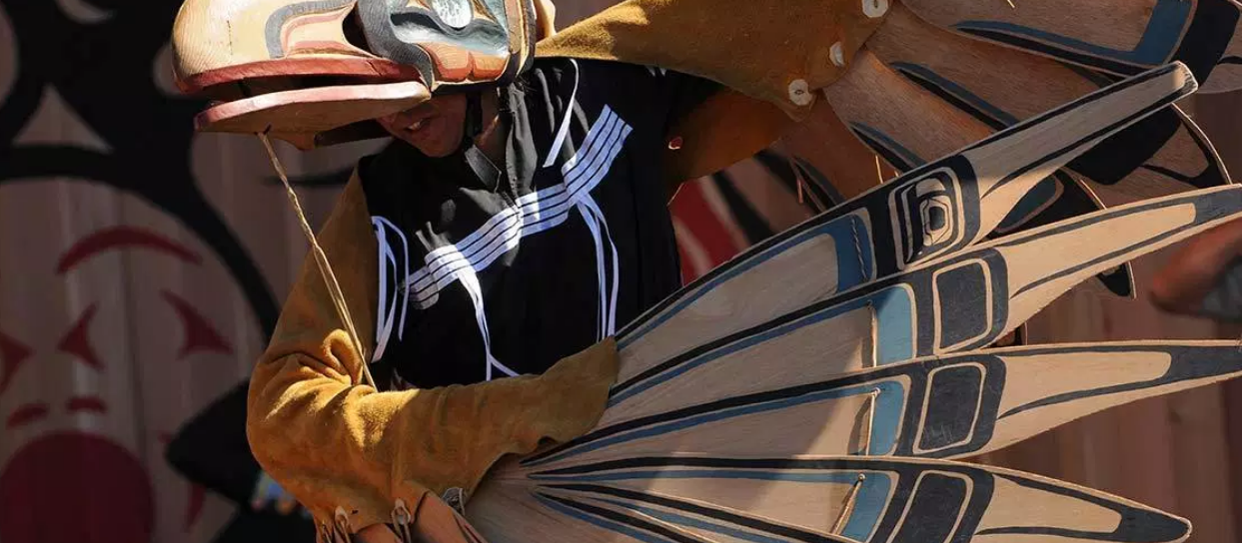
Indigenous Law
Connecting Communities with Information
Julia Fekete & Mitchell Moncur

Slide 2
Learning Objectives
  Historical & Modern Treaties
  The Indian Act
  Landmark Cases in Canada
  Truth & Reconciliation Commission of Canada
  Gladue Reports
  Restorative Justice
  Aboriginal Law LibGuide
  ATRIS Exercise

Slide 3
Historical & Modern Treaties
The Supreme Court lists 5 considerations if a document is a treaty:
Continuous exercise of a right in the past and at present
The reasons that the Crown made a commitment
The situation prevailing at the time the document was signed
Evidence of relations of mutual respect and esteem between negotiators
Subsequent conduct of the parties

Slide 4
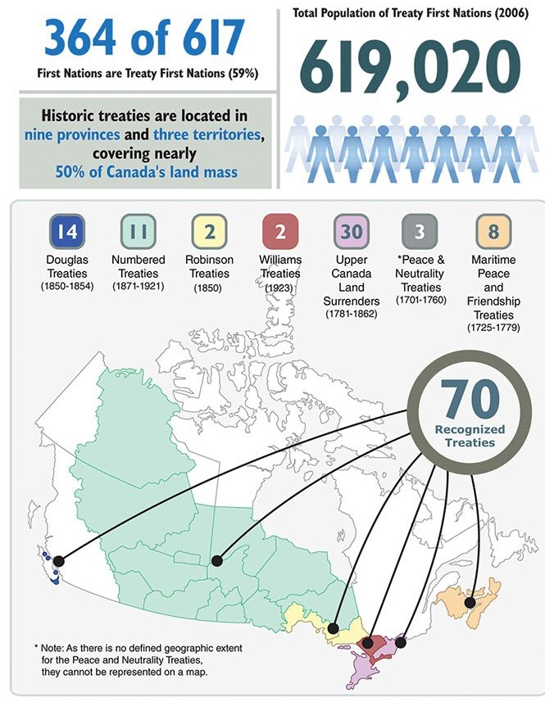
Historical Treaties
Historic Treaties includes:
Treaties of Peace and Neutrality (1701 - 1760)
Peace and Friendship Treaties (1725 - 1779)
Upper Canada Land Surrenders (1764 - 1862)
Robinson Treaties / Douglas Treaties (1850 - 1854)
The numbered Treaties (1871 - 1921)
The treaty-making process was formally established by the Royal Proclamation of 1763
(Canada, 2013)

Slide 5
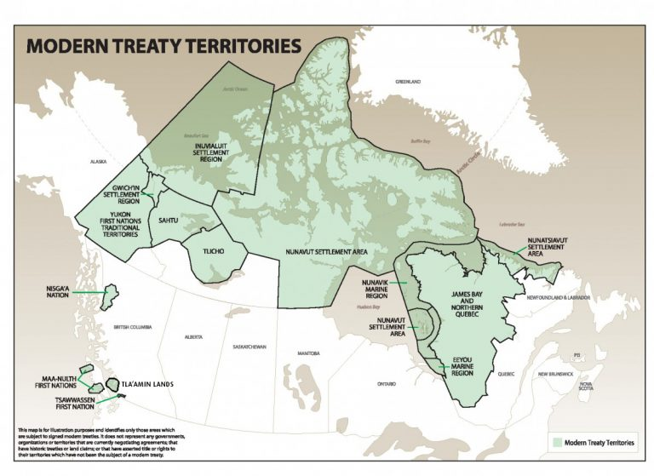
Modern Treaties or Comprehensive Land Claims
Modern Treaties includes:
Ownership, Mgmt & Use of:
  land, water and natural resources
Environmental protection
Employment / Government contracting
Examples:
Calder et al. v. Attorney-General of British Columbia
James Bay and Northern Québec Agreement
(“LCAC_Map_of_Modern_Treaties-new-768x559.jpeg (JPEG Image, 768 × 559 pixels),” n.d.)

Slide 6
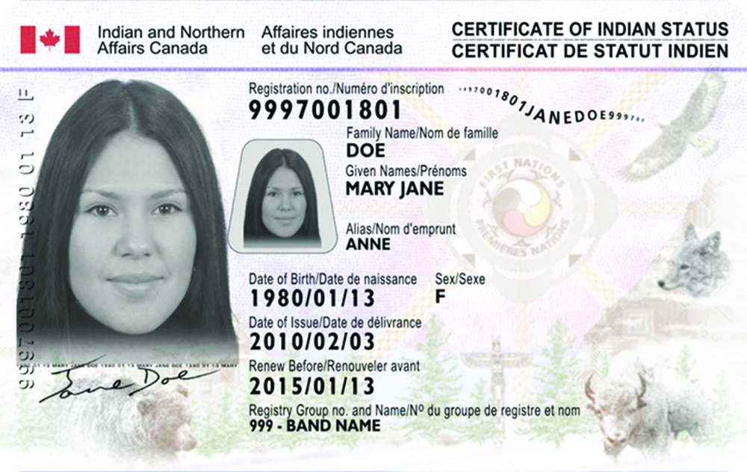
The Indian Act
Gradual Civilization Act (1857)
The “Potlatch Law” & Section 141 (1884)
1951 Amendments
The White Paper (1969)
Bill C-31 (1985)
Why not abolish the Indian Act?
(Jones, 2018)

Slide 7
Landmark Cases in Canada
Canadian Law has 2 main sources:
Legislation such as the Indian Act and
Court decisions.
Canada’s supreme law is found in the Constitution of Canada.
section 35 of the Constitution Act (1982) recognized and affirmed the existing Aboriginal and treaty rights of the Aboriginal peoples of Canada.
Canadian courts have taken on the task of defining them.

Slide 8
Landmark Cases in Canada
St Catherine’s Milling and Lumber Company vs Queen 1885
Calder Case 1973
Guerin v. The Queen 1984
Hamlet of Baker Lake v. Minister of Indian affairs and northern development 1980
  Baker Lake test 1980
Sparrow Case 1990 *
Delfamuukw v. British Columbia 1997
Beckman v. Little Salmon / Marmacks First Nation Nov 19, 2010
Marshall case: R v. Marshall 1999

Slide 9
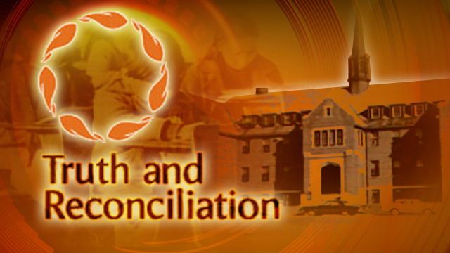
Truth & Reconciliation Commission of Canada
Result of the Indian Residential Schools Settlement Agreement (IRSSA)
Largest settlement packages in the history of Canada
TRC Final Report
  7,000 statements from survivors
Common Experience Payment (CEP)
  3.1 billion as of January 2017
Independent Assessment Process (IAP)
(Alberta, 2015)

Slide 10

R V Gladue: The Case of Jamie Tanis Gladue
The Case: September 16, 1995, Jamie Tanis Gladue, a young Cree woman, celebrates 19th birthday in Nanaimo, BC
What was considered?
Aggravating factors and absence of any serious criminal history.
What wasn’t considered?
Traumatic past
Criticism
Overly narrow viewpoint.
Legacy
In 1999, Gladue Courts and Gladue reports were created
Notes:
“Gladue refers to a right that Aboriginal People have under section 718.2 (e) of the Criminal Code.” A sentencing principle that acknowledges the systematic racism and discrimination they face which results with over representation of their communities in the criminal law and justice system. It directs the courts to take into account the history of the offender and directs the courts to seek, "all available sanctions, other than imprisonment".
Jaime Gladue was not on reserve land at the time of the offense and therefore her s. 718.2(e) rights were never taken into consideration.,
Later noted and stated that section 718.2(e) applies to “all aboriginal persons wherever they reside, whether on- or off-reserve, in a large city or a rural area”.^{[1]}

Slide 11
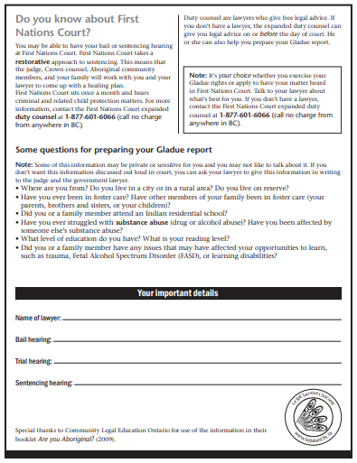
Gladue Reports
What do they contain?
Recommends appropriate sentence
Includes background info on the offender: history regarding residential schools, child welfare removal, physical or sexual abuse, underlying developmental or health issues, or substance use.
Who does it apply to?
All self-identified Aboriginal People living in or outside of an Aboriginal community.
Also applies to breaches of long-term supervision orders.
Notes:
- A pre-sentencing or bail hearing report, usually prepared by Gladue caseworkers at the request of the judge, defense counsel or Crown Attorney.
- These people do not have to hold status, can self identify as an Indigenous person
- When considering long-term supervision The ruling stated that “failing to take [Aboriginal] circumstances into account would violate the fundamental principle of sentencing”

Slide 12

Gladue: Problems
Equal Representation: The Case of NorthWest Territories
No Gladue writers could be located in Yellowknife, or Hay River
unclear whether, or how often Gladue is applied in cases in these locations.
Ignoring Gladue
Judges, parole officers and others within the criminal law system poorly understand what systemic discrimination is
Not enough Gladue writers.
(https://nanlegal.on.ca/gladue/)

Slide 13
Restorative Justice
https://www.youtube.com/watch?v=8N3LihLvfa0
https://www.youtube.com/watch?v=RTb85GNcAVc

Slide 14
Indigenous Law LibGuide
https://libraryguides.mcgill.ca/law-aboriginal
All resources are available to the public,
  With exception to the HeinOnline’s Aboriginal Resources Database… Which is American??
Today, we are going to look at :
  First Nations Gazette
  Indigenous Peoples’ Center for Documentation, Research and Information
  Crown-Indigenous Relations and Northern Affairs Canada

Slide 15
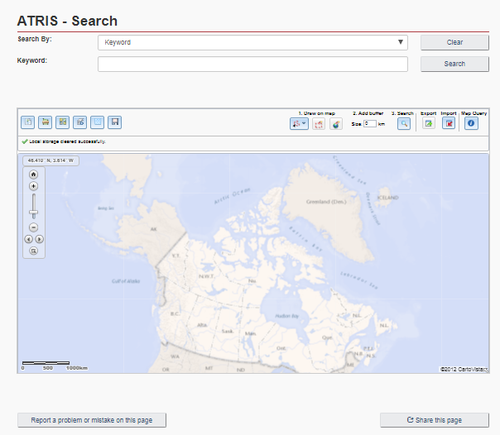
ATRIS: Aboriginal and Treaty Rights Information System
Access to documents and maps
Contains information on:
Indigenous communities and organizations
Treaties and agreements
Claims and negotiations
Court cases and decisions
Consultation related information
http://sidait-atris.aadnc-aandc.gc.ca/atris_online/home-accueil.aspx
Notes:
Also links reports with related geographic shapes on an interactive map, allowing users to locate Indigenous groups and become familiar with each group's established or asserted rights.

Slide 16
Sources
Alberta, M. N. of. (2015, December 15). Final Truth and Reconciliation Report Released. Retrieved October 30, 2019, from Métis Nation of Alberta website:
http://albertametis.com/2015/12/final-truth-and-reconciliation-report-released/
ATRIS: https://www.aadnc-aandc.gc.ca/eng/1100100014686/1100100014687
Canada, G. of C. I. and N. A. (2013, September 26). Historic Treaties and Treaty First Nations in Canada Infographic [Reference material]. Retrieved October 30, 2019, from
https://www.rcaanc-cirnac.gc.ca/eng/1380223988016/1544125243779
Jones, D. (2018, August 3). Changes to Indian Act could see more status membership. Retrieved October 30, 2019, from MBC Radio website:
https://www.mbcradio.com/2018/08/changes-to-indian-act-could-see-more-status-membership
Gladue: https://www.justiceeducation.ca/about-us/research/aboriginal-people-and-sentencing
LCAC_Map_of_Modern_Treaties-new-768x559.jpeg (JPEG Image, 768 × 559 pixels). (n.d.). Retrieved October 30, 2019, from
http://activehistory.ca/wp-content/uploads/2016/09/LCAC_Map_of_Modern_Treaties-new-768x559.jpeg
McGill Libguides: https://libraryguides.mcgill.ca/law-aboriginal
Truth and Reconciliation Commission of Canada: http://www.trc.ca/

